Slide 1
DESIGN IMPACT MOVEMENT PRODUCT SHOWCASE WORKBOOK
ADAPTIVE EQUIPMENT BIKE RIDING FOR LOWER LIMB AMPUTEES
TEAM NAME : MOBILITY INNOVATORS
BY 1.DHANUSRI K
2.ARIKARAN R
3.AJAY S
4.LOGANADAN M
A Social Initiative
by Titan Company Ltd.

Slide 2
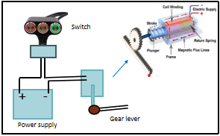
TECHNOLOGY STACK
Enhancing their mobility and independence and this contribute to more active fulfilling life style
Participating in activities like bike riding can have positive impact on a individuals mental and emotional well-being
It represents the significant step in the field of prosthetics and assistive technology
It enhance the overall rehabilitation
DESIGNIMPACTMOVEMENT.TITAN.IN

Slide 3
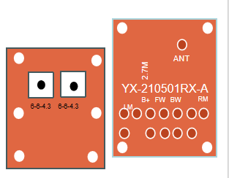
EMPATHY
Our issues of riding motorbikes in lower limb amputees.
Aim is to discover the hand operate bike gears.
The switch is connected to the PCB board transmitter and the Receiver is connected to the stepper motor
When the switch is pressed towards front the pinion gear is moves towards front and the first gear falls
discover will be useful to resolve the practical
PCB TRANSMITTER AND RECEIVER BOARD

Slide 4
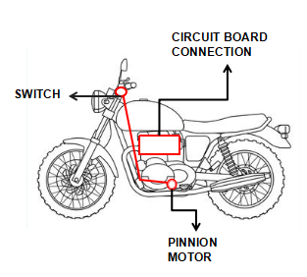
IDEATE
These advancement enable amputees to participating group rides fostering social connections and sence of community
It encouraging other facing similar challenges to pursue their passions and lead active lives
The technological progress in the field of assistive devices
It is a therapeutic benefits for amputees
DESIGNIMPACTMOVEMENT.TITAN.IN

Slide 5
CAUSE AND APPROACH
Future scope :
In future by practising they can also join in the bike racing ,they can also come out of th zone to make them prove to everyone
They can also live like a normal humans
Future upgrade :
In future it will be developed to lower limb amputees in both legs to access the gear and as well as back brake
In future it will be implemented in super bikes to experience themselves

